Slide 1
Lecture 7: Function Calls and Recursion
Dr. Tsung-Wei Huang
Department of Electrical and Computer Engineering
University of Utah, Salt Lake City, UT
Notes:
Morning everyone
Today we are looking into control flow in C++.

Slide 2
Recap: Function Definition
The format of a function definition is as follows:
return-value-type function-name( parameter-list ) { declarations and statements }
The function-name is any valid identifier.
The return-value-type is the data type of the returned result to the caller.
The type void indicates that a function does not return a value.
All variables defined in a function are local variables—they’re known only in the function in which they’re defined.
Most functions have a list of parameters that provide the means for communicating information between functions.
A function’s parameters are also local variables of that function.

Slide 3
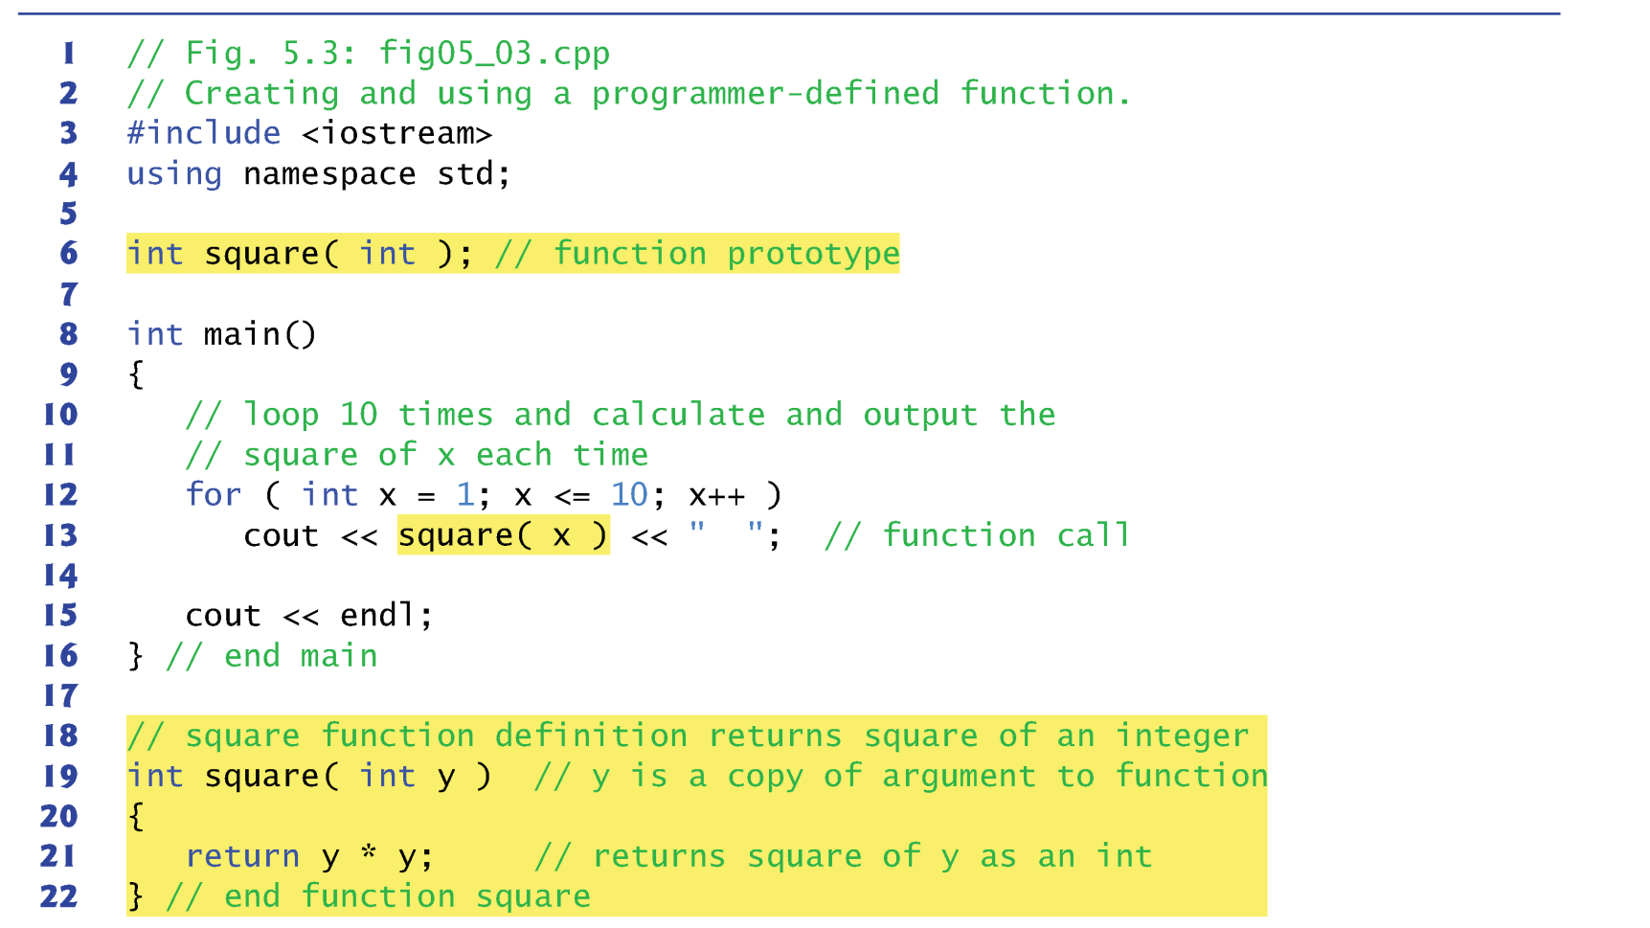
Example

Slide 4
Call by Value vs Call by Reference
Call by value
copies the actual value of an argument into the formal parameter of the function
Call by reference
copies the address of an argument into the formal parameter

Slide 5
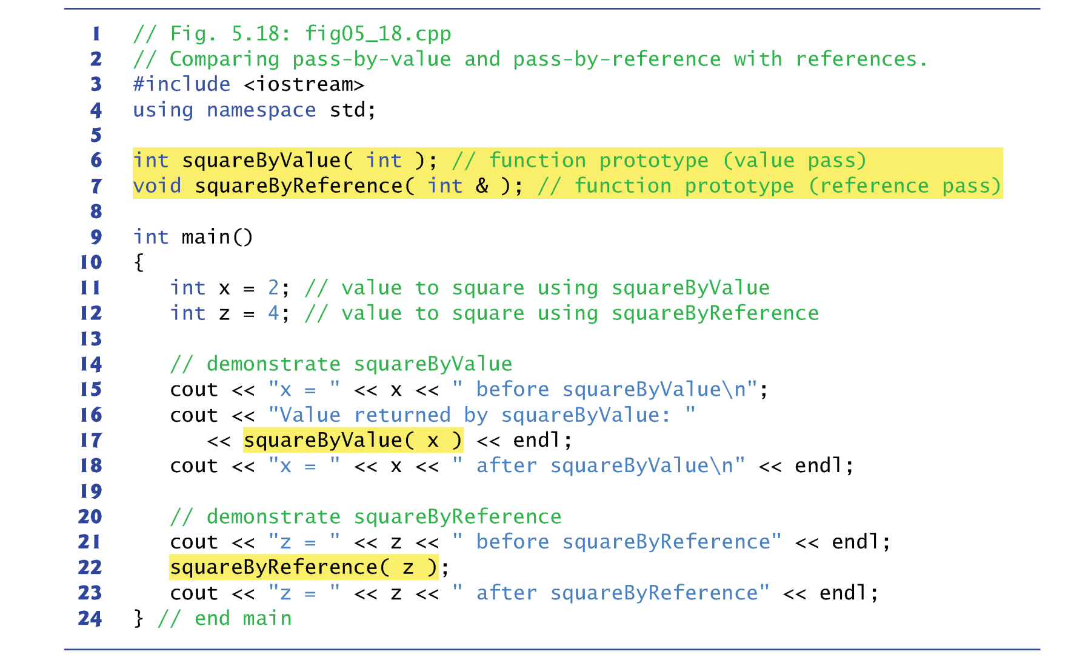
Call by Value vs Call by Reference

Slide 6
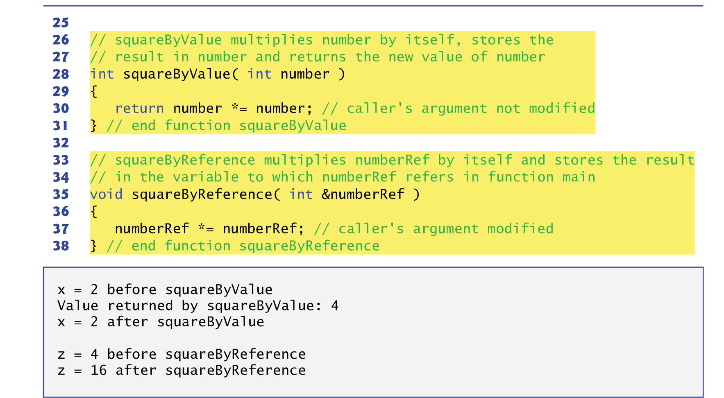
Call by Value vs Call by Reference

Slide 7
Reference is ”Alias”
References can also be used as aliases for other variables within a function.
For example, the code
int count = 1; // declare integer variable count int &cRef = count; // create cRef as an alias for count cRef++; // increment count (using its alias cRef)
increments variable count by using its alias cRef.
Reference variables must be initialized in their declarations and cannot be reassigned as aliases to other variables.
Once a reference is declared as an alias for another variable, all operations performed on the alias are actually performed on the original variable.

Slide 8
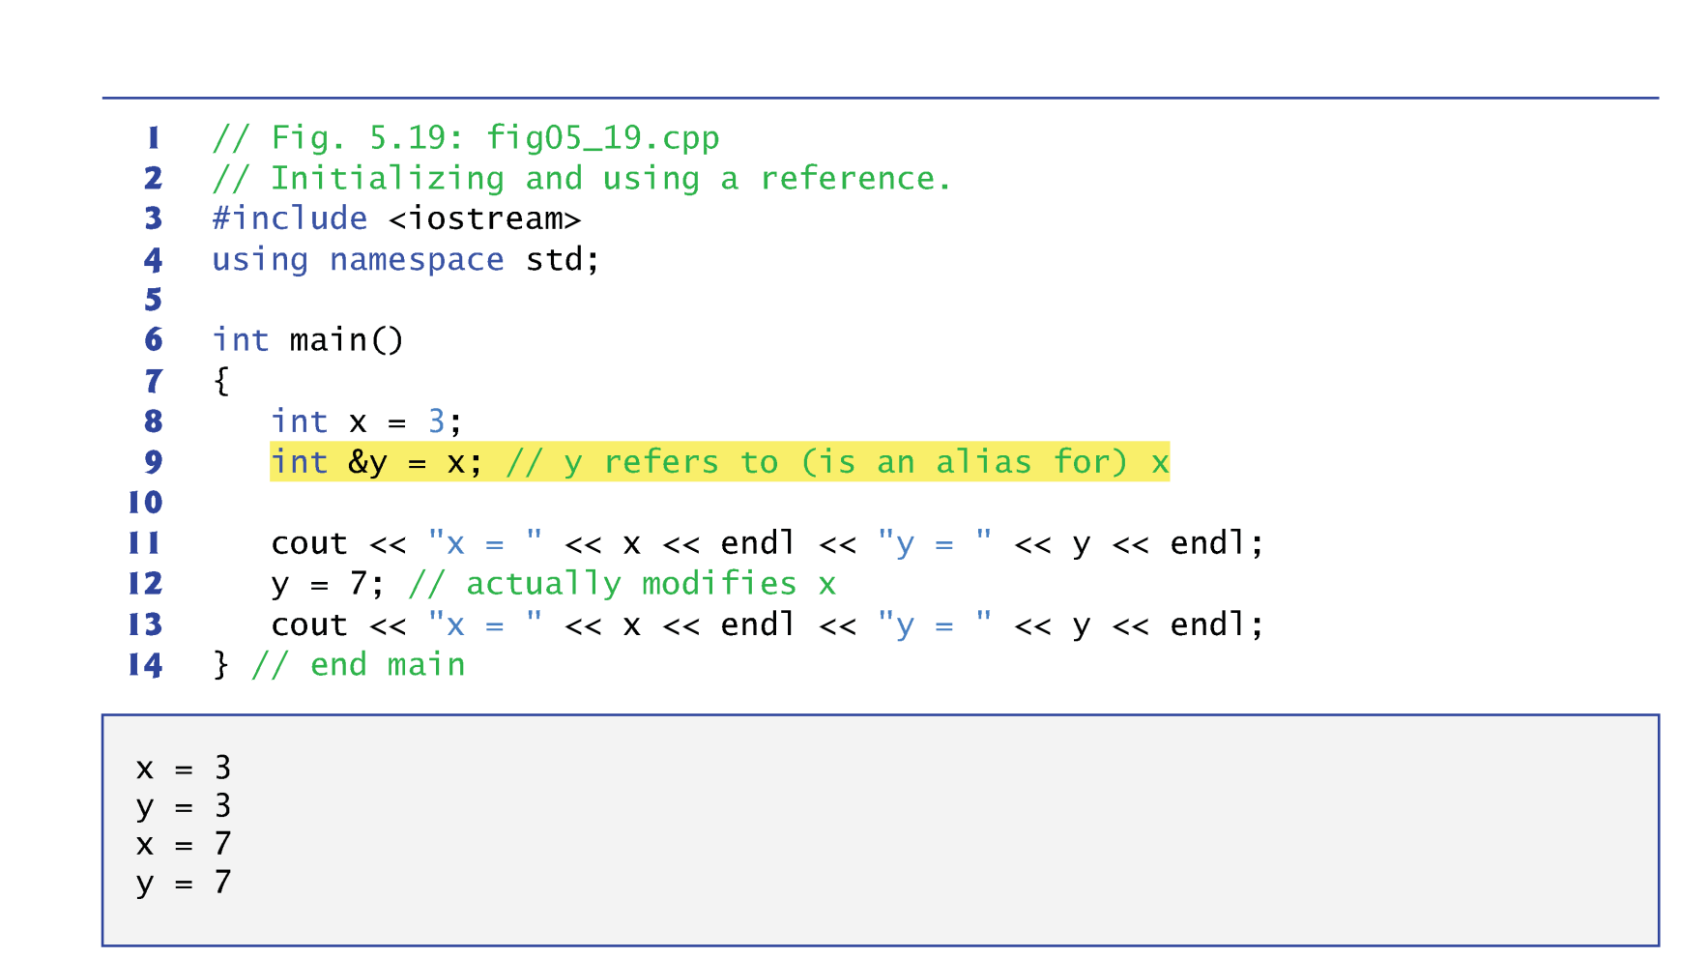
Reference is “Alias”

Slide 9
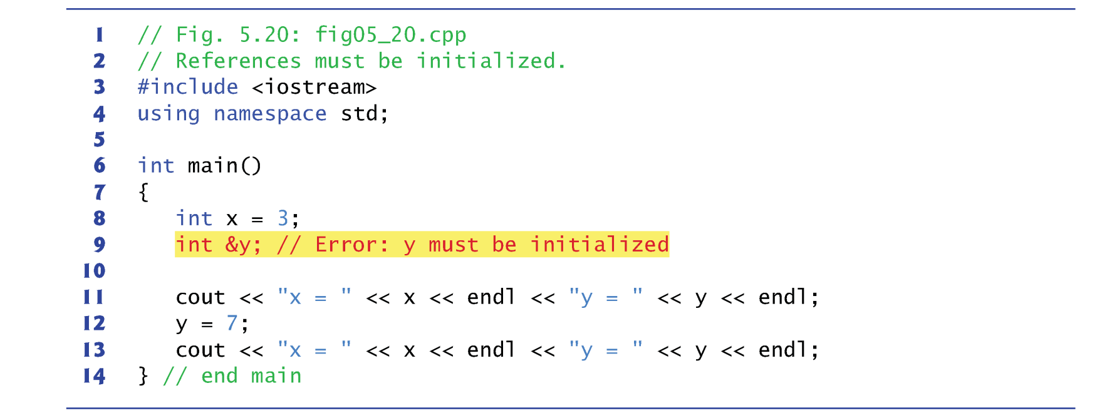
Reference must be Initialized!

Slide 10
Recursive Function
A recursive function is a function that calls itself, either directly, or indirectly (through another function).
The function only knows how to solve the simplest case(s), or so-called base case(s).
If the function is called with a base case, the function simply returns a result
For complex problem, the function divides a problem into
What it can do (base case) → return the result
What it cannot do → resemble the original problem, but be a slightly simpler or smaller version
The function calls a new copy of itself (recursion step) to solve the smaller problem
Eventually base case gets solved
Gets plugged in, works its way up and solves whole problem

Slide 11
Fibonacci Number (iterative)
Write a function named ”fib" that takes a positive integer N and returns the N-th Fibonacci number
e.g. N=6, returns 8
e.g. N=9, returns 34

Slide 12
Fibonacci Number (Recursive)
Write a function named ”fib" that takes a positive integer N and returns the N-th Fibonacci number
e.g. N=6, returns 8
e.g. N=9, returns 34
?

Slide 13
Duplicate Computations …
Fib(5)
Fib(4)
Fib(3)
Fib(3)
Fib(2)
Fib(2)
Fib(1)
Fib(2)
Fib(1)
Notes:
Now let's take a look at how this algorithm work

Slide 14
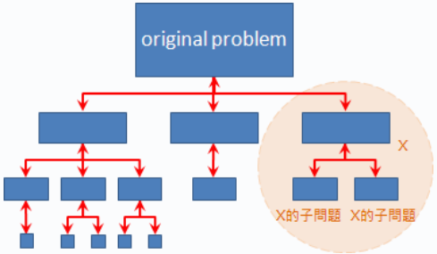
Divide and Conquer
Divide & Conquer
Divide: Divide the original problem into smaller subproblems
Recurse: Solve each small subproblem recursively
Conquer: Combine these subproblems all the way to the top
Illustration
subproblems
Notes:
Now we understand what recursion works, it's time to dive into divide and conquer. A normal divide and conquer algorithm has three steps: divide, recurse, and conquer.
Divide ...
Recurse: ...
Conquer:
In terms of figure, it looks like this. (explain)

Slide 15
Visualization of Divide and Conquer
Divide
If small
else
Solve Directly

Slide 16
Visualization of Divide and Conquer
Recursive

Slide 17
Visualization of Divide and Conquer
Solve and Conquer

Slide 18
Example: Find the Maximum Value
Divide
29
14
15
01
06
10
32
12
Notes:
Now let's take a look at a simpler example, finding the maximum value in a linear sequence of numbers. For example, in this sequence I have 29, 14, ... (explain) and the maximum value I need to return is 1 and that is the forth element from the beginning.
First step, divide, the convention is to divide the problem by 2, breaking the sequence into tow equal size halfs.
...

Slide 19
Example: Find the Maximum Value
Divide
29
14
15
01
06
10
32
12
29
14
15
01
Notes:
Now let's take a look at a simpler example, finding the maximum value in a linear sequence of numbers. For example, in this sequence I have 29, 14, ... (explain) and the maximum value I need to return is 1 and that is the forth element from the beginning.
First step, divide, the convention is to divide the problem by 2, breaking the sequence into tow equal size halfs.
...

Slide 20
Example: Find the Maximum Value
Divide
29
14
15
01
06
10
32
12
29
14
15
01
29
14
15
01
Notes:
Now let's take a look at a simpler example, finding the maximum value in a linear sequence of numbers. For example, in this sequence I have 29, 14, ... (explain) and the maximum value I need to return is 1 and that is the forth element from the beginning.
First step, divide, the convention is to divide the problem by 2, breaking the sequence into tow equal size halfs.
...

Slide 21
Example: Find the Maximum Value
Divide
29
14
15
01
06
10
32
12
29
14
15
01
06
10
32
12
29
14
15
01
Notes:
Now let's take a look at a simpler example, finding the maximum value in a linear sequence of numbers. For example, in this sequence I have 29, 14, ... (explain) and the maximum value I need to return is 1 and that is the forth element from the beginning.
First step, divide, the convention is to divide the problem by 2, breaking the sequence into tow equal size halfs.
...

Slide 22
Example: Find the Maximum Value
Divide
29
14
15
01
06
10
32
12
29
14
15
01
06
10
32
12
29
14
15
01
06
10
32
12
Notes:
Now let's take a look at a simpler example, finding the maximum value in a linear sequence of numbers. For example, in this sequence I have 29, 14, ... (explain) and the maximum value I need to return is 1 and that is the forth element from the beginning.
First step, divide, the convention is to divide the problem by 2, breaking the sequence into tow equal size halfs.
...

Slide 23
Example: Find the Maximum Value
Conquer
29
14
15
01
06
10
32
12
Notes:
A partition with two elements seems pretty reasonable to solve. I can simply compare these two numbers and return the maximum, right.
So I will compare 29 with 14 and return 29 as the maximum from my partition. I am returning 29 to the previous recursion. At the same time, on the right hand side, I am comparing 15 with 01, and apparently 1 is smaller than 15 so I return 15 to the previous recursion.
Same for the other two blocks ...
Now I have the maximum from each partition, the conquer part is to find the maximum value from the returned values of partitions. So, here I will compare 29 with 15 ...
You may ask, can't I just do a linear scan over the sequence and I will find the maximum number? What is the advantage of doing this in divide and conquer kinda more complex?

Slide 24
Example: Find the Maximum Value
Conquer
29
15
29
14
15
01
06
10
32
12
Notes:
A partition with two elements seems pretty reasonable to solve. I can simply compare these two numbers and return the maximum, right.
So I will compare 29 with 14 and return 29 as the maximum from my partition. I am returning 29 to the previous recursion. At the same time, on the right hand side, I am comparing 15 with 01, and apparently 1 is smaller than 15 so I return 15 to the previous recursion.
Same for the other two blocks ...
Now I have the maximum from each partition, the conquer part is to find the maximum value from the returned values of partitions. So, here I will compare 29 with 15 ...
You may ask, can't I just do a linear scan over the sequence and I will find the maximum number? What is the advantage of doing this in divide and conquer kinda more complex?

Slide 25
Example: Find the Maximum Value
Conquer
29
15
10
32
29
14
15
01
06
10
32
12
Notes:
A partition with two elements seems pretty reasonable to solve. I can simply compare these two numbers and return the maximum, right.
So I will compare 29 with 14 and return 29 as the maximum from my partition. I am returning 29 to the previous recursion. At the same time, on the right hand side, I am comparing 15 with 01, and apparently 1 is smaller than 15 so I return 15 to the previous recursion.
Same for the other two blocks ...
Now I have the maximum from each partition, the conquer part is to find the maximum value from the returned values of partitions. So, here I will compare 29 with 15 ...
You may ask, can't I just do a linear scan over the sequence and I will find the maximum number? What is the advantage of doing this in divide and conquer kinda more complex?

Slide 26
Example: Find the Maximum Value
Conquer
29
32
29
15
10
32
29
14
15
01
06
10
32
12
Notes:
A partition with two elements seems pretty reasonable to solve. I can simply compare these two numbers and return the maximum, right.
So I will compare 29 with 14 and return 29 as the maximum from my partition. I am returning 29 to the previous recursion. At the same time, on the right hand side, I am comparing 15 with 01, and apparently 1 is smaller than 15 so I return 15 to the previous recursion.
Same for the other two blocks ...
Now I have the maximum from each partition, the conquer part is to find the maximum value from the returned values of partitions. So, here I will compare 29 with 15 ...
You may ask, can't I just do a linear scan over the sequence and I will find the maximum number? What is the advantage of doing this in divide and conquer kinda more complex?

Slide 27
Example: Find the Maximum Value
Conquer
32
29
32
29
15
10
32
29
14
15
01
06
10
32
12
Notes:
A partition with two elements seems pretty reasonable to solve. I can simply compare these two numbers and return the maximum, right.
So I will compare 29 with 14 and return 29 as the maximum from my partition. I am returning 29 to the previous recursion. At the same time, on the right hand side, I am comparing 15 with 01, and apparently 1 is smaller than 15 so I return 15 to the previous recursion.
Same for the other two blocks ...
Now I have the maximum from each partition, the conquer part is to find the maximum value from the returned values of partitions. So, here I will compare 29 with 15 ...
You may ask, can't I just do a linear scan over the sequence and I will find the maximum number? What is the advantage of doing this in divide and conquer kinda more complex?

Slide 28

Divide and Conquer is Heavily used in CAD
Modern circuits sizes are too large to handle in flat
2000 – Intel Pentium4
42M transistors
1.5MHz; 224 mm²
Directly solving the original problem takes forever to finish …
Notes:
Like I said, Divide and Conquer is heavily used in CAD. Modern circuit sizes are just too large to handle in flat. If you do this, it means billions of transistors at one time. You have no hope to finish it in a reaonsable amount of time. To give you a sense on the size, when I was working in IBM ....( explore )

Slide 29
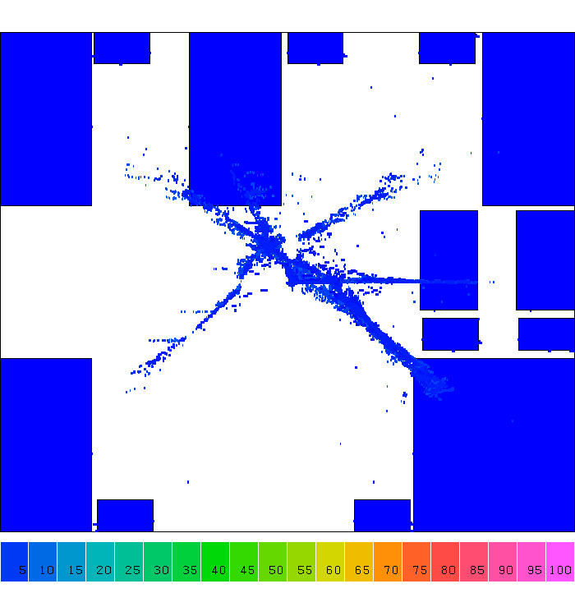
Example: Placement
Notes:
Let's take a look at one step of computer design, placement. A placement is a step that tries to find the location of each gate, you know Or gate, NAND gate, NOT gate, and other gates, in a chip area. And we have billions of gate to place in a finger size chip.
Computer design tools don't do this. They do this in divide and conquer. (explain)

Slide 30
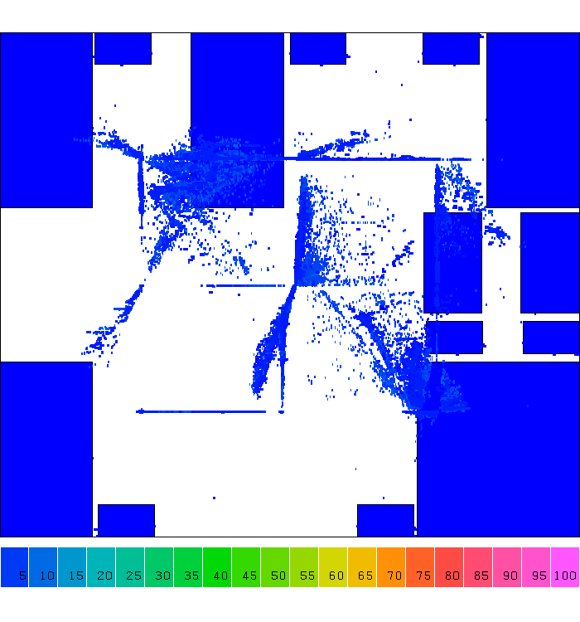
Example: Placement

Slide 31
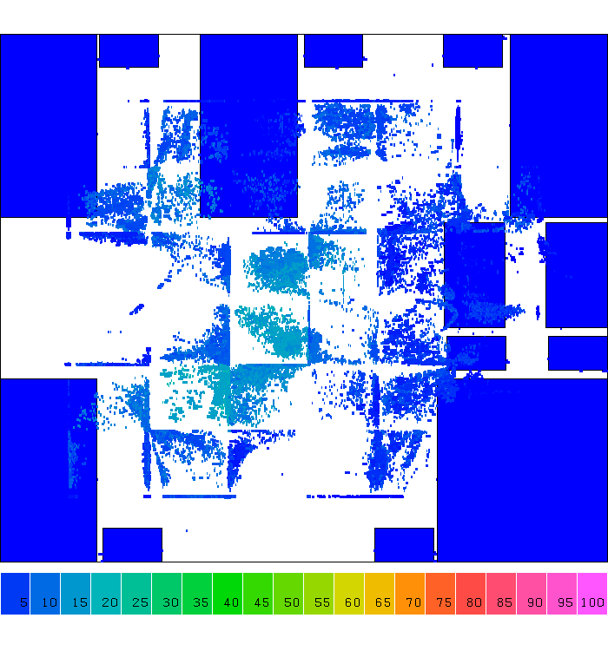
Example: Placement

Slide 32
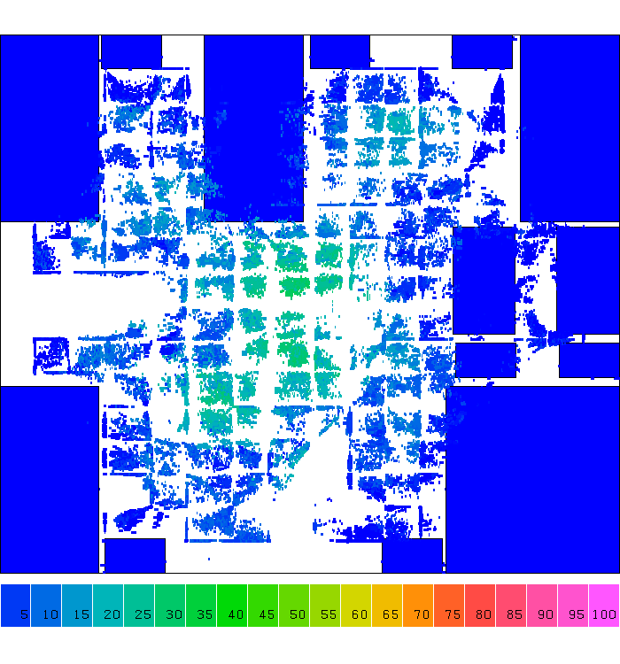
Example: Placement

Slide 33
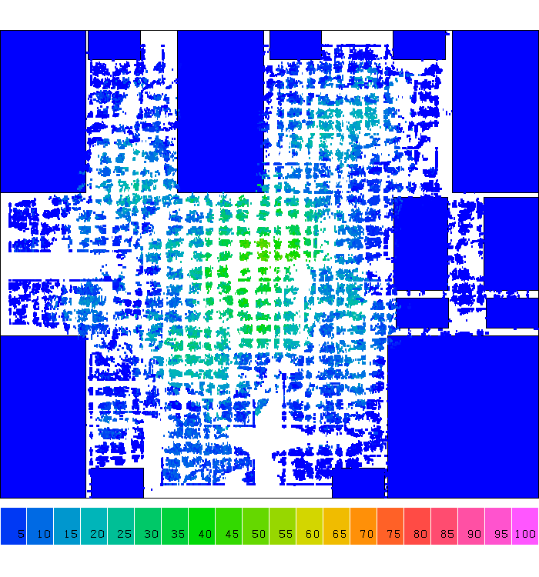
Example: Placement

Slide 34
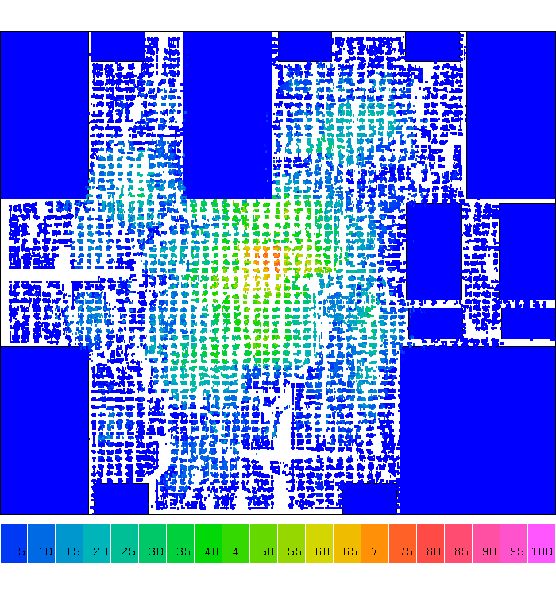
Example: Placement

Slide 35
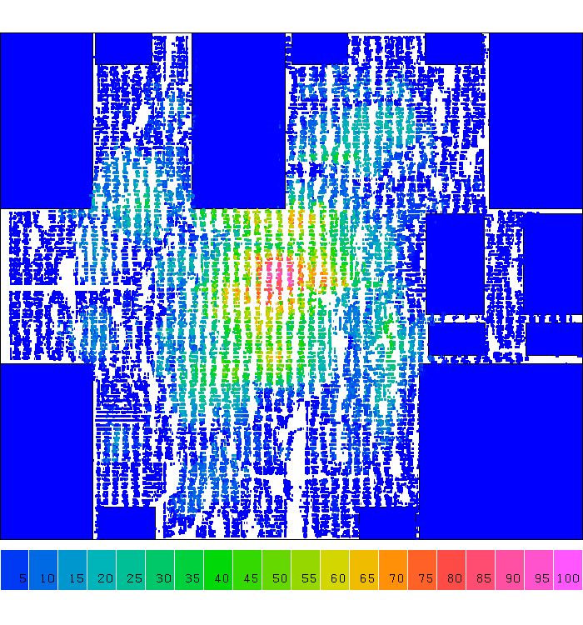
Example: Placement

Slide 36
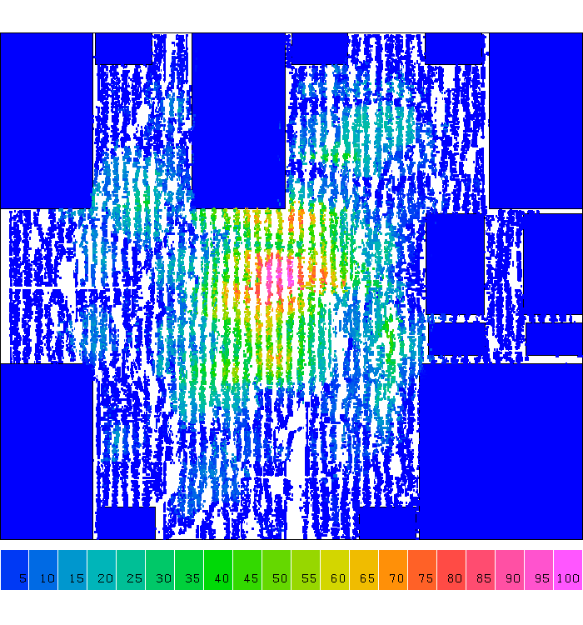
Example: Placement
Notes:
So, from iteration to iteration you can clearly see cells are placed very regularly, right, Cells are spreading along the 2D grid partition. We partition the large chip care into smaller grids and place cells in those small grids. Solving the smaller grid problem is definitely more efficiently than directly handling the original problem.

Slide 37
Summary
Function
Recursive Function
Divide and Conquer
Used to solve 90% of the computer science problems
Break a large problem into smaller pieces
Solve each smaller piece
Merge the solutions
PA 4 is announced (due 10/29 23:59 PM)
Midterm will start next Friday class time
Take-home exam with one week to finish

Slide 38
LAB #1: Lower Bound of Sum
Write two functions named ”boundary_iterative” and “boundary_recursive” that both takes one integer argument, call it "goal" and return as its value the smallest positive integer n for which 1+2+3+. . . +n is at least equal or larger than “goal”
e.g. boundary_iterative(9) returns 4, as 1+2+3+4 >= 9 but 1+2+3<9
e.g., boundary_recursive(21) returns 6, as 1+2+3+4+5+6=21 but 1+2+3+4+5<21

Slide 39
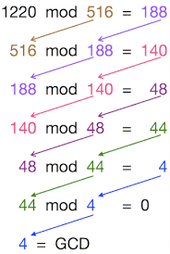
LAB #2: Iterative and Recursive GCD
Write two functions named ”gcd_iterative” and “gcd_recursive” that both take two positive integers and return their greatest common divisor (GCD) using iterative for-loop and recursion
e.g. gcd_iterative(1220, 516) = 4
e.g. gcd_recursive(1220, 516) = 4

